Slide 1
LVMT: An Efficient Authenticated Storage for Blockchain
OSDI 2023
Chenxing Li Sidi Mohamed Beillahi† Guang Yang Ming Wu Wei Xu‡ Fan Long†
Shanghai Tree-Graph Blockchain Research Institute
University of Toronto† Tsinghua University‡
王子平

Slide 2


Evolution of blockchain performance
Early blockchain systems are slow
< 30 Transaction/Seconds
Reaches 20000 Transaction/Seconds
Resolved bottlenecks
Consensus Protocal
Next bottleneck
Execution
81% of trasaction execution time consumed on storage layer !

Slide 3
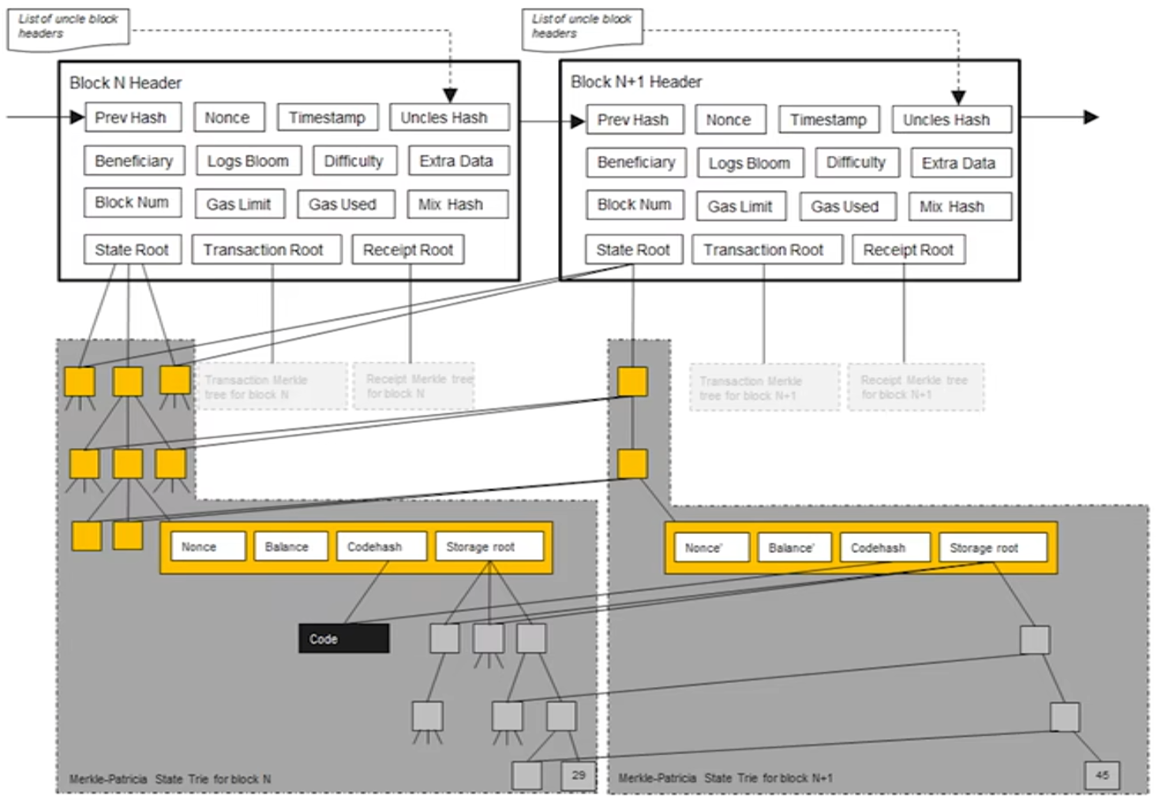
Architecture of the blockchain Storage
Account-based model
Key : Account
Value : Balance 、Nonce etc.
Authenticated Data Structure

Slide 4
Architecture of the blockchain execution layer
In a Permission-less & Account-based Blockchain System
Ordered Transaction
Stack-based Virtual Machine
Cache
Key-value Storage
Disk I/O Amplification
1 read, 1 write
Authenticated
Data Structure
4 read, 8 write
Backend Key-value Database

Slide 5

Authenticated Storage
Query a key
Server
(full node)
Client
(light node)
Answer the value with proof
Key-value Storage
Verify proof
with commitment
...
Compute a
commitment
block header
Put in block
Read from block
block body
...

Slide 6
Merkle Tree
Variants : MPT, RainBlocks, LMPTs
root hash
commitment
Update commitment in O(logn)
Proof generation in O(logn)
Each node is the
hash value of its children
Input vector

Slide 7
AMT
Variants for blockchain system: LVMT
root hash
Update commitment in O(1)
Proof generation in O(logn)
commitment
Input vector

Slide 8
Challenges in using AMT
1. Fast in complexity ≠ fast in practice
AMT has slow cryptographic operations
2. AMT is not scalable as MPT
Max capacity of AMT = Size of public parameters
3. Proof generation is Expensive
Maintaining data for generating proofs is also O(logn)

Slide 9
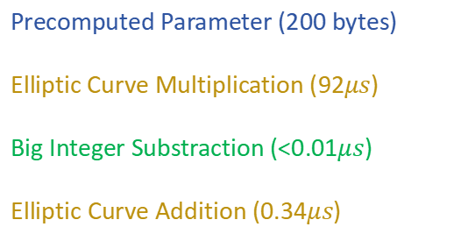

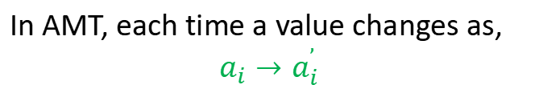

Challenge 1 : Costly cryptographic operations
In AMT, each time a value changes as,
$$a_{i}→a_{i}^{’}$$
The commitment adjusts accordingly,
$$C→C + ∙G_{i}$$
$$(a_{i}^{’} − a_{i})$$
1
Precomputed Parameter (200 bytes)
Elliptic Curve Multiplication (92$μs$)
Big Integer Substraction (<0.01$μs$)
Elliptic Curve Addition (0.34$μs$)

Slide 10

Solution 1 : Version-based database
Increase ver of
key by 1
Store tuple
(Key, Ver, Val, loc)
(Key ，Value)
AMT
Append Only
Merkle trees
(Key ，Version)
$$a_{i}→a_{i}^{’}=1$$
key →ver
(key，ver) → (val, loc )

Slide 11
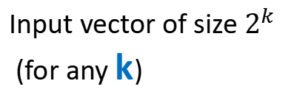
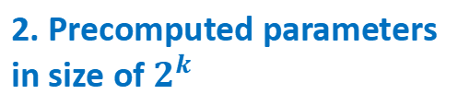
Challenge 2 : AMT is not scalable
Vecctor Index
ver | 00
 | 01
 | 10
 | 11
Take as input
AMT
Maintain
commitment
Input vector of size $2^{k}$
(for any k)
2. Precomputed parameters in size of $2^{k}$
32 bit for 256GB
1. Determined at the setup phase
3. Blockchain has 256-bit key space, but k = 256 is infeasible

Slide 12
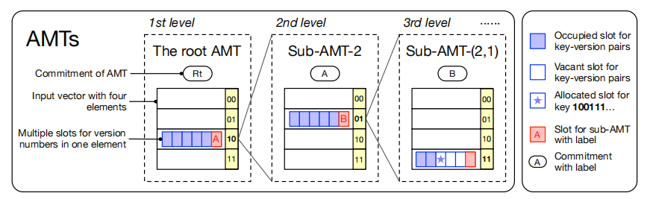
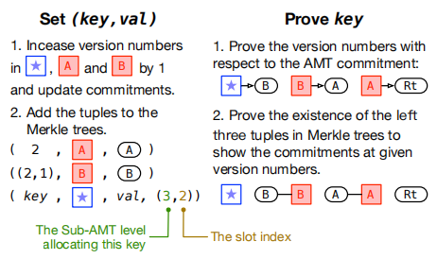
Solution 2 : Use multi-level AMT

Slide 13
Challenge 3 : Maintaining proof data incurs significant costs
Nodes not serving clients only need to maintain commitment in O(1) time
commitment
Nodes serving clients maintain auxiliary information of size O(nlogn) for generating proof in O(logn) time
Sub-AMT

Slide 14
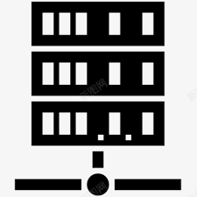
Solution 3 : Proof Sharding
Collaborate to offer proof generation
Full node 1
Full node 2
......
1 | 0 | 1 | 0 | ......
1 | 0 | 1 | 1 | ......
......
......
Service Provider
Proof Shard
Proof Shard
Proof Shard
Proof Shard

Slide 15
Evaluation
Execution Task
1m
10m
100m
Random task on various ledger size(in million)
fresh
Randomly access new keys only
real
Real Ethereum trace
Authenticated Data
Structure
LVMT-r
Only maintain commitment，no proof
LVMT#
#: The fraction of proof shards
MPT
RAIN
LMPTs
Baselines
Key-Value Database

Slide 16
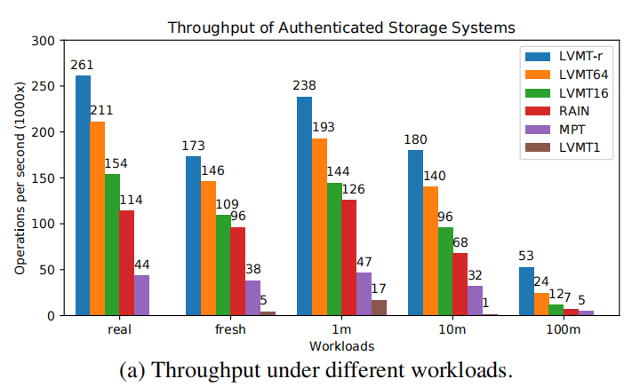
Evaluation
>80% improvement
20% discount
40% discount
>353% improvement
Notes:
LVMT-r分别领先了MPT和RAIN至少 353% 和 80% 这说明LVMT的架构在性能上提升了，增加了proof sharding 的 LVMT64 和 LVMT16 的吞吐量分别是LVMT-r吞吐量的 80% 和 60%，而LVMT-1的吞吐量非常低，这说明proof sharding非常重要

Slide 17
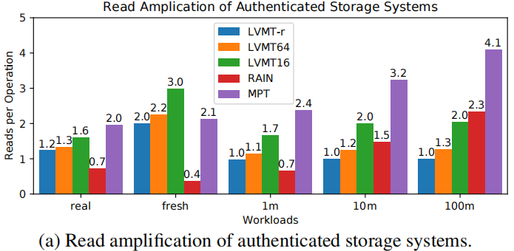
Evaluation
Notes:
LVMT-r做到了只产生很有限的放大，并且随着账本规模扩大时表现也比较稳定，这是因为2层的AMT就能够支撑20billion version numbers 这意味着Task在达到一个较大阈值之前AMT的深度Y也不会发生太大变化

Slide 18
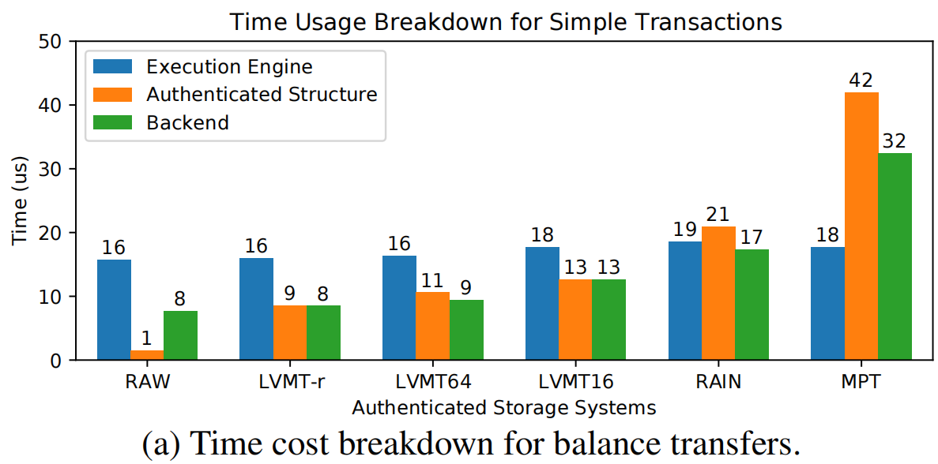
Evaluation
Notes:
LVMT-r和LVMT64所用的时间和直接访问数据库的时间是差不多的，并且LVMT相比RAIN和MPT，在authenticated structure上所付出的维护成本也降低了，这说明LVMT确实降低了authenticated storage的overhead

Slide 19
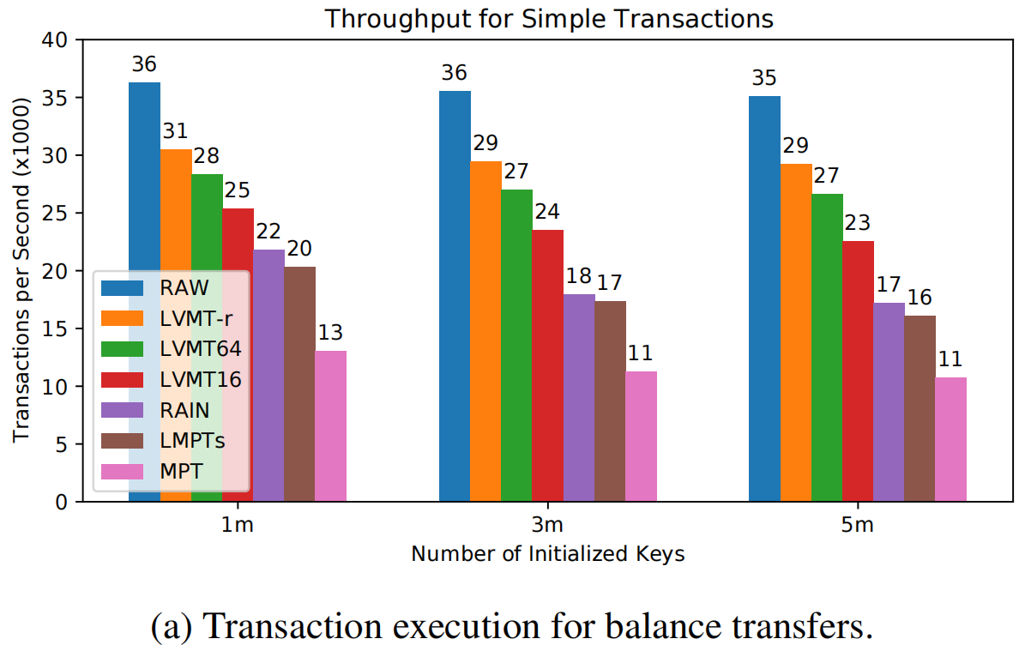
Evaluation
1.7x
2.7x
Notes:
end-to-end测试中 LVMT-r的吞吐量分别是RAIN和MPT的1.7倍和2.7倍

Slide 20
Rethinking
1. LVMT still need auxiliary information of size O(nlogn) for generating proof in O(logn) time and LVMT relies too much on proof sharding
2. Optimizing Cache mechanism to reduce database access

Slide 21
Implementation
AMT implementation
Arkworks -- a Rust library for elliptic curve operations
AMT -- parameters BN254 and key=16
public parameters in KZG commitment -- Perpetual-Powers-of-Tau ceremony
MPT implementation
OpenEthereum client (Rust)
variant RainBlock
LVMT implementation
KM, VM, LM to store value, version, slot index
AMT key=16 makes

